Slide 1
Intersection Problem
Traffic flow comparison of roundabouts with crossroads controlled by traffic lights, including pedestrians
Marcel Arikan, Nuhro Ego, Ralf Kohrt
HS 2012
© ETH Zürich |
Notes:
18.12.12
1

Slide 2
Abstract
Cellular Automata
Nagel-Schreckenberg
Parameters: car and pedestrian density
Roundabouts are up to 2x more efficient than crossroads, but collapse at high pedestrian densities
2
Notes:
18.12.12
2

Slide 3
Introduction and Motivation
Development of “Traffic Dynamics” by Tony Wood and Bastian Bücheler in May 2010
Added pedestrians and traffic lights, instead of “priority to the right”-organisation
From daily life experience: roundabouts have disadvantages!
3

Slide 4
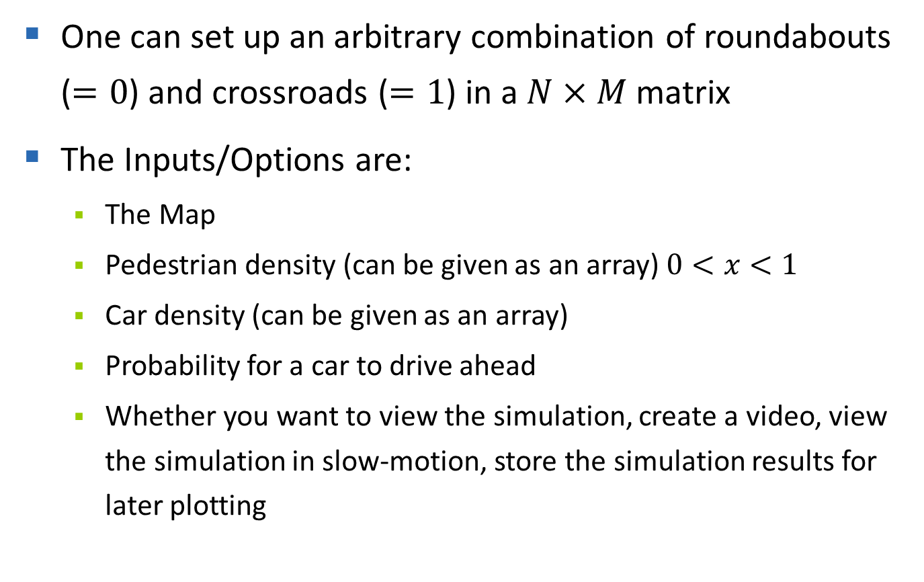
Main Loop
One can set up an arbitrary combination of roundabouts ($=0$) and crossroads ($=1$) in a $N×M$ matrix
The Inputs/Options are:
The Map
Pedestrian density (can be given as an array) $0<x<1$
Car density (can be given as an array)
Probability for a car to drive ahead
Whether you want to view the simulation, create a video, view the simulation in slow-motion, store the simulation results for later plotting
4
Notes:
18.12.12
4

Slide 5
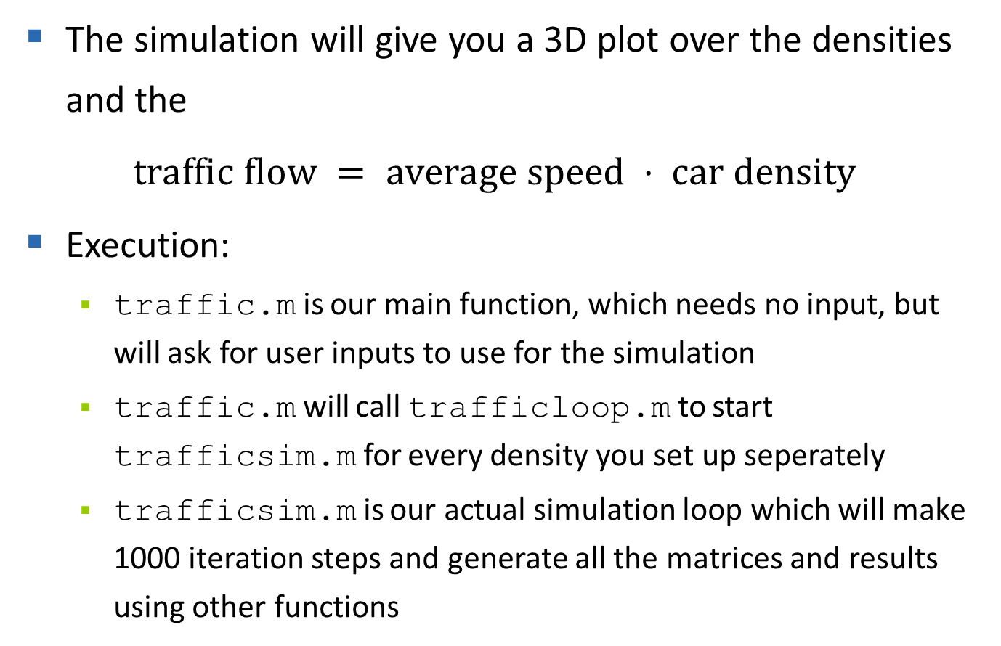
Main Loop
The simulation will give you a 3D plot over the densities and the
$traffic flow = average speed ⋅ car density$
Execution:
traffic.m is our main function, which needs no input, but will ask for user inputs to use for the simulation
traffic.m will call trafficloop.m to start trafficsim.m for every density you set up seperately
trafficsim.m is our actual simulation loop which will make 1000 iteration steps and generate all the matrices and results using other functions
5
Notes:
18.12.12
5

Slide 6
Roundabout
Consists of 12 cells for the loop and 4 roads with pedestrian crossings
Pedestrians have priority over cars if the road is free
Cars inside the roundabout have priority over cars outside
Car speed is limited to 1 cell per iteration step
The exit a car will take is computed according to the probability for cars going ahead
6
Notes:
18.12.12
6

Slide 7
Roundabout - Implementation
We are using many arrays to calculate the next time step in the roundabout.m function
3 for the circle of the roundabout
8 pedestrian 'buckets'
The roundabout.m function handles 8 cells of each incoming/outgoing lane and all the cars inside the circle
7
Notes:
18.12.12
7

Slide 8
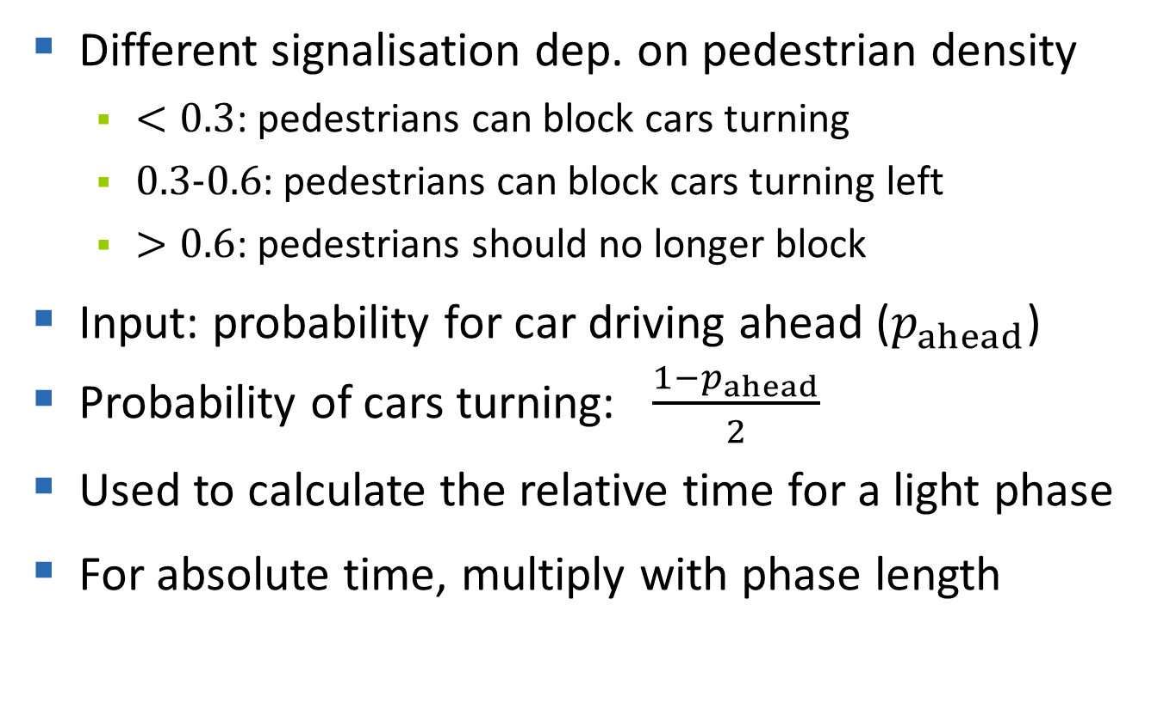
Crossroad with traffic lights (1)
Different signalisation dep. on pedestrian density
$<0.3$: pedestrians can block cars turning
$0.3$-$0.6$: pedestrians can block cars turning left
$>0.6$: pedestrians should no longer block
Input: probability for car driving ahead ($p_{ahead}$)
Probability of cars turning: $\frac{1−p_{ahead}}{2}$
Used to calculate the relative time for a light phase
For absolute time, multiply with phase length
8

Slide 9
Crossroad with traffic lights (2)
Control is not dynamic
For different crossroads: phase offset depending on car density
Nagel-Schreckenberg model in crossroad
Cars ahead: speed up to 5 cells per it.
Cars turning: speed up to 2 cells per it.
9

Slide 10
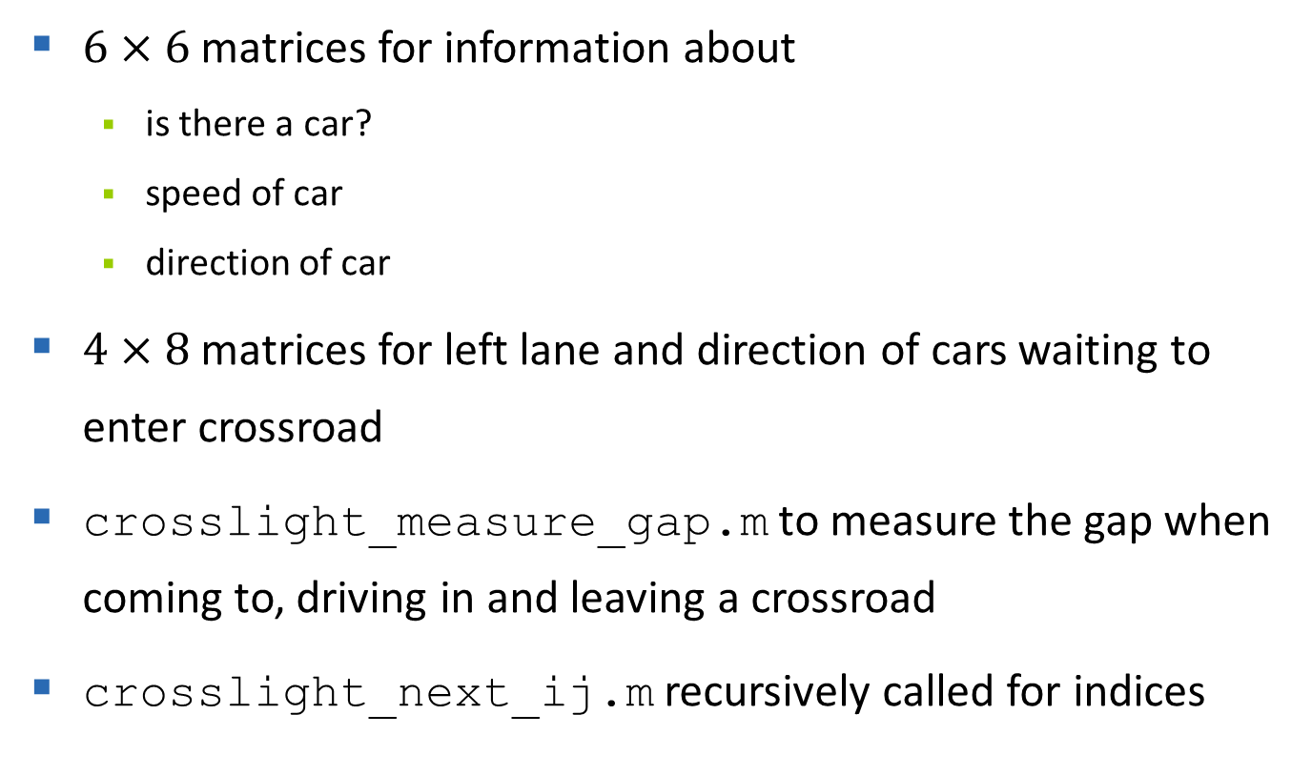
Implementation of crossroad
$6×6$ matrices for information about
is there a car?
speed of car
direction of car
$4×8$ matrices for left lane and direction of cars waiting to enter crossroad
crosslight_measure_gap.m to measure the gap when coming to, driving in and leaving a crossroad
crosslight_next_ij.m recursively called for indices
10

Slide 11
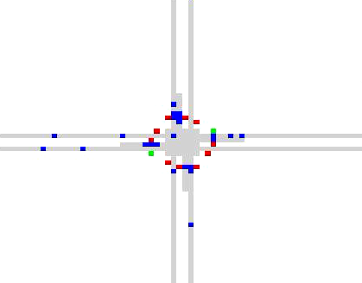
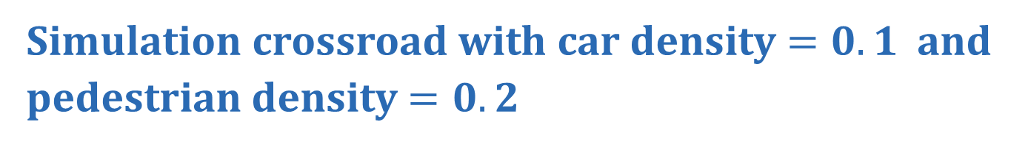
Simulation crossroad with car density $=0.1$ and pedestrian density $=0.2$
11

Slide 12
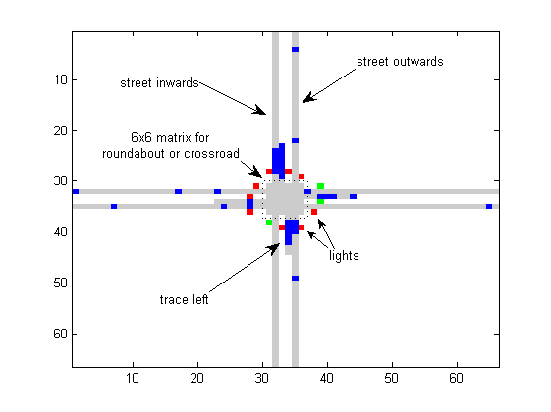
Implementation of crossroad
12

Slide 13
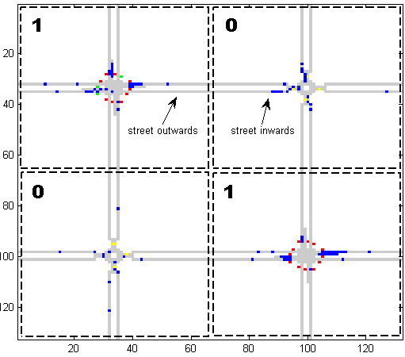
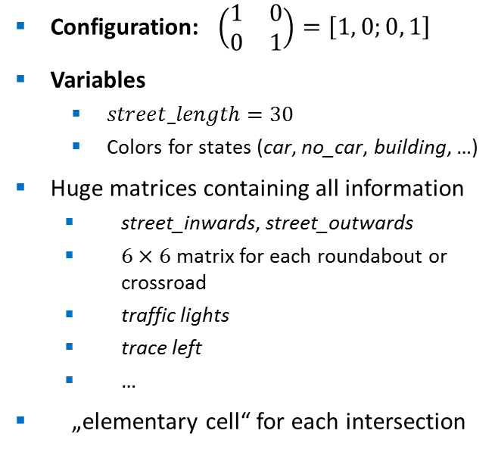
Graphical Implementation (1)
Configuration: $\left(\begin{matrix}1 & 0 \\ 0 & 1\end{matrix}\right)=\left[1, 0;0, 1\right]$
Variables
$street_length=30$
Colors for states (car, no_car, building, …)
Huge matrices containing all information
street_inwards, street_outwards
$6×6$ matrix for each roundabout or crossroad
traffic lights
trace left
…
„elementary cell“ for each intersection
13

Slide 14
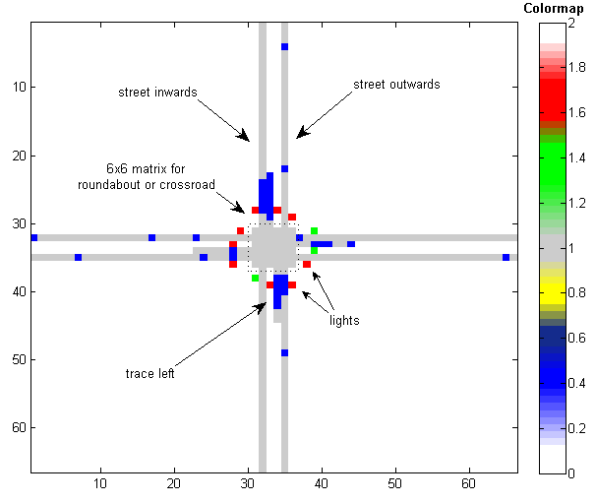
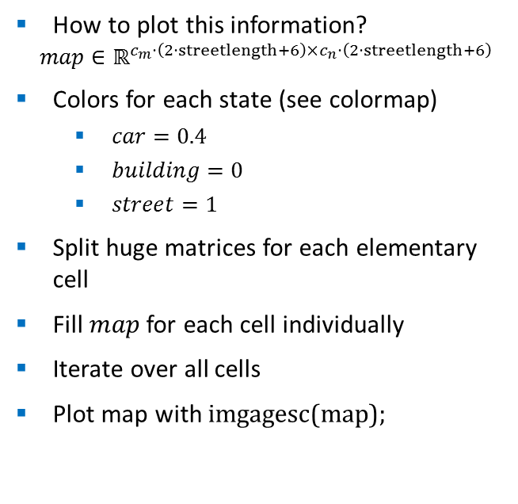
Graphical Implementation (2)
How to plot this information?
$$map∈ℝ^{c_{m}⋅\left(2⋅streetlength+6\right)×c_{n}⋅\left(2⋅streetlength+6\right)}$$
Colors for each state (see colormap)
$car=0.4$
$building=0$
$street=1$
Split huge matrices for each elementary cell
Fill $map$ for each cell individually
Iterate over all cells
Plot map with imgagesc(map);
14

Slide 15
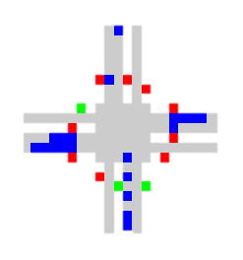
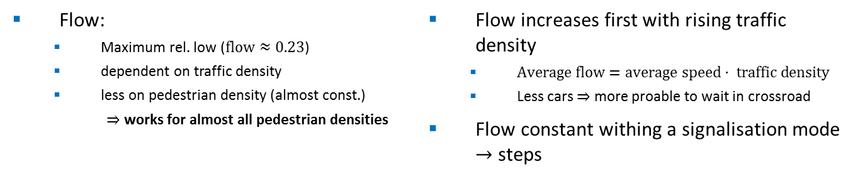
Single Crossroad
Flow:
Maximum rel. low ($flow≈0.23$)
dependent on traffic density
less on pedestrian density (almost const.)
$⇒$ works for almost all pedestrian densities
Flow increases first with rising traffic density
$Average flow=average speed⋅ traffic density$
Less cars $⇒$ more proable to wait in crossroad
Flow constant withing a signalisation mode $→$ steps
15

Slide 16
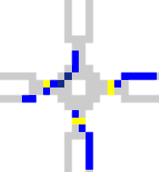
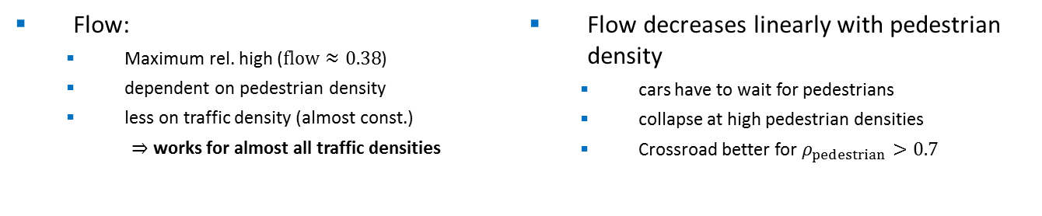
Single Roundabout
Flow:
Maximum rel. high ($flow≈0.38$)
dependent on pedestrian density
less on traffic density (almost const.)
$⇒$ works for almost all traffic densities
Flow decreases linearly with pedestrian density
cars have to wait for pedestrians
collapse at high pedestrian densities
Crossroad better for $ρ_{pedestrian}>0.7$
16

Slide 17
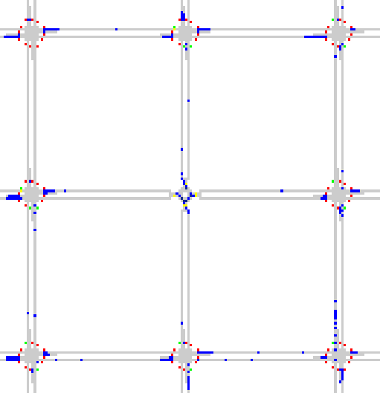
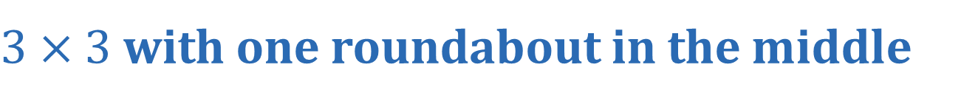
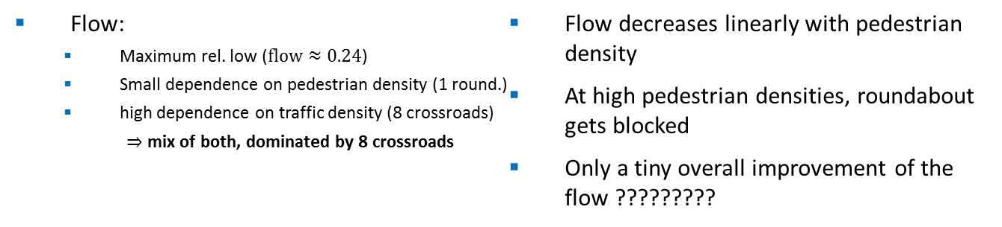
$3×3$ with one roundabout in the middle
Flow:
Maximum rel. low ($flow≈0.24$)
Small dependence on pedestrian density (1 round.)
high dependence on traffic density (8 crossroads)
$⇒$ mix of both, dominated by 8 crossroads
Flow decreases linearly with pedestrian density
At high pedestrian densities, roundabout gets blocked
Only a tiny overall improvement of the flow ?????????
17

Slide 18
Summary
Roundabouts are much more efficient at low pedestrian densities and crossroads are more efficient at high pedestrian densities – so the increasing use in our cities is reasonable
Our result with low pedestrian densities is comparable to the results of Wood and Bücheler
COMPARISON WITH OTHER GROUP????
18
Notes:
18.12.12
18

Slide 19
Outlook
The signalisation rules need to be optimized (which is clearly visible from the plots)
More intelligent traffic control could optimize our traffic lights
At high pedestrian densities one could control pedestrian crossings in front of roundabouts with traffic lights
19
Notes:
18.12.12
19

Slide 20
Thank you for your attention.
QUESTIONS?
Notes:
18.12.12
20

Slide 21
References
Elmar Brockfeld, Robert Barlovic, Andreas Schadschneider, Michael Schreckenberg: Optimizing traffic lights in a cellular automaton model for city traffic. Physical Review E, Volume 64, 2001.
Tony Wood, Bastian Bücheler. Traffic Flow Comparison of Roundabouts and Crossroads. May 2010
Layout of presentation:
Karsten Donnay, Stefano Balietti. Modeling and Simulating Social Systems with MATLAB. Course Powerpoints, 2012
21

